Slide 1


Welcome to the Workshop!
Workshop Website https://go.wisc.edu/3183gc
Etherpad (for collaborative notes and questions) https://go.wisc.edu/f778p7
Make sure you can connect to your Cyverse account!
Notes:
cyverse important announcements

Slide 2

Welcome to Data Carpentry!
August 5-6 & 12, 2019
Instructors: Trisha Adamus, Steve Goldstein, Christina Koch, Tobin Magle, Elizabeth McDaniel, Sarah Stevens, Sailendharan Sudakaran
Host:

Slide 3
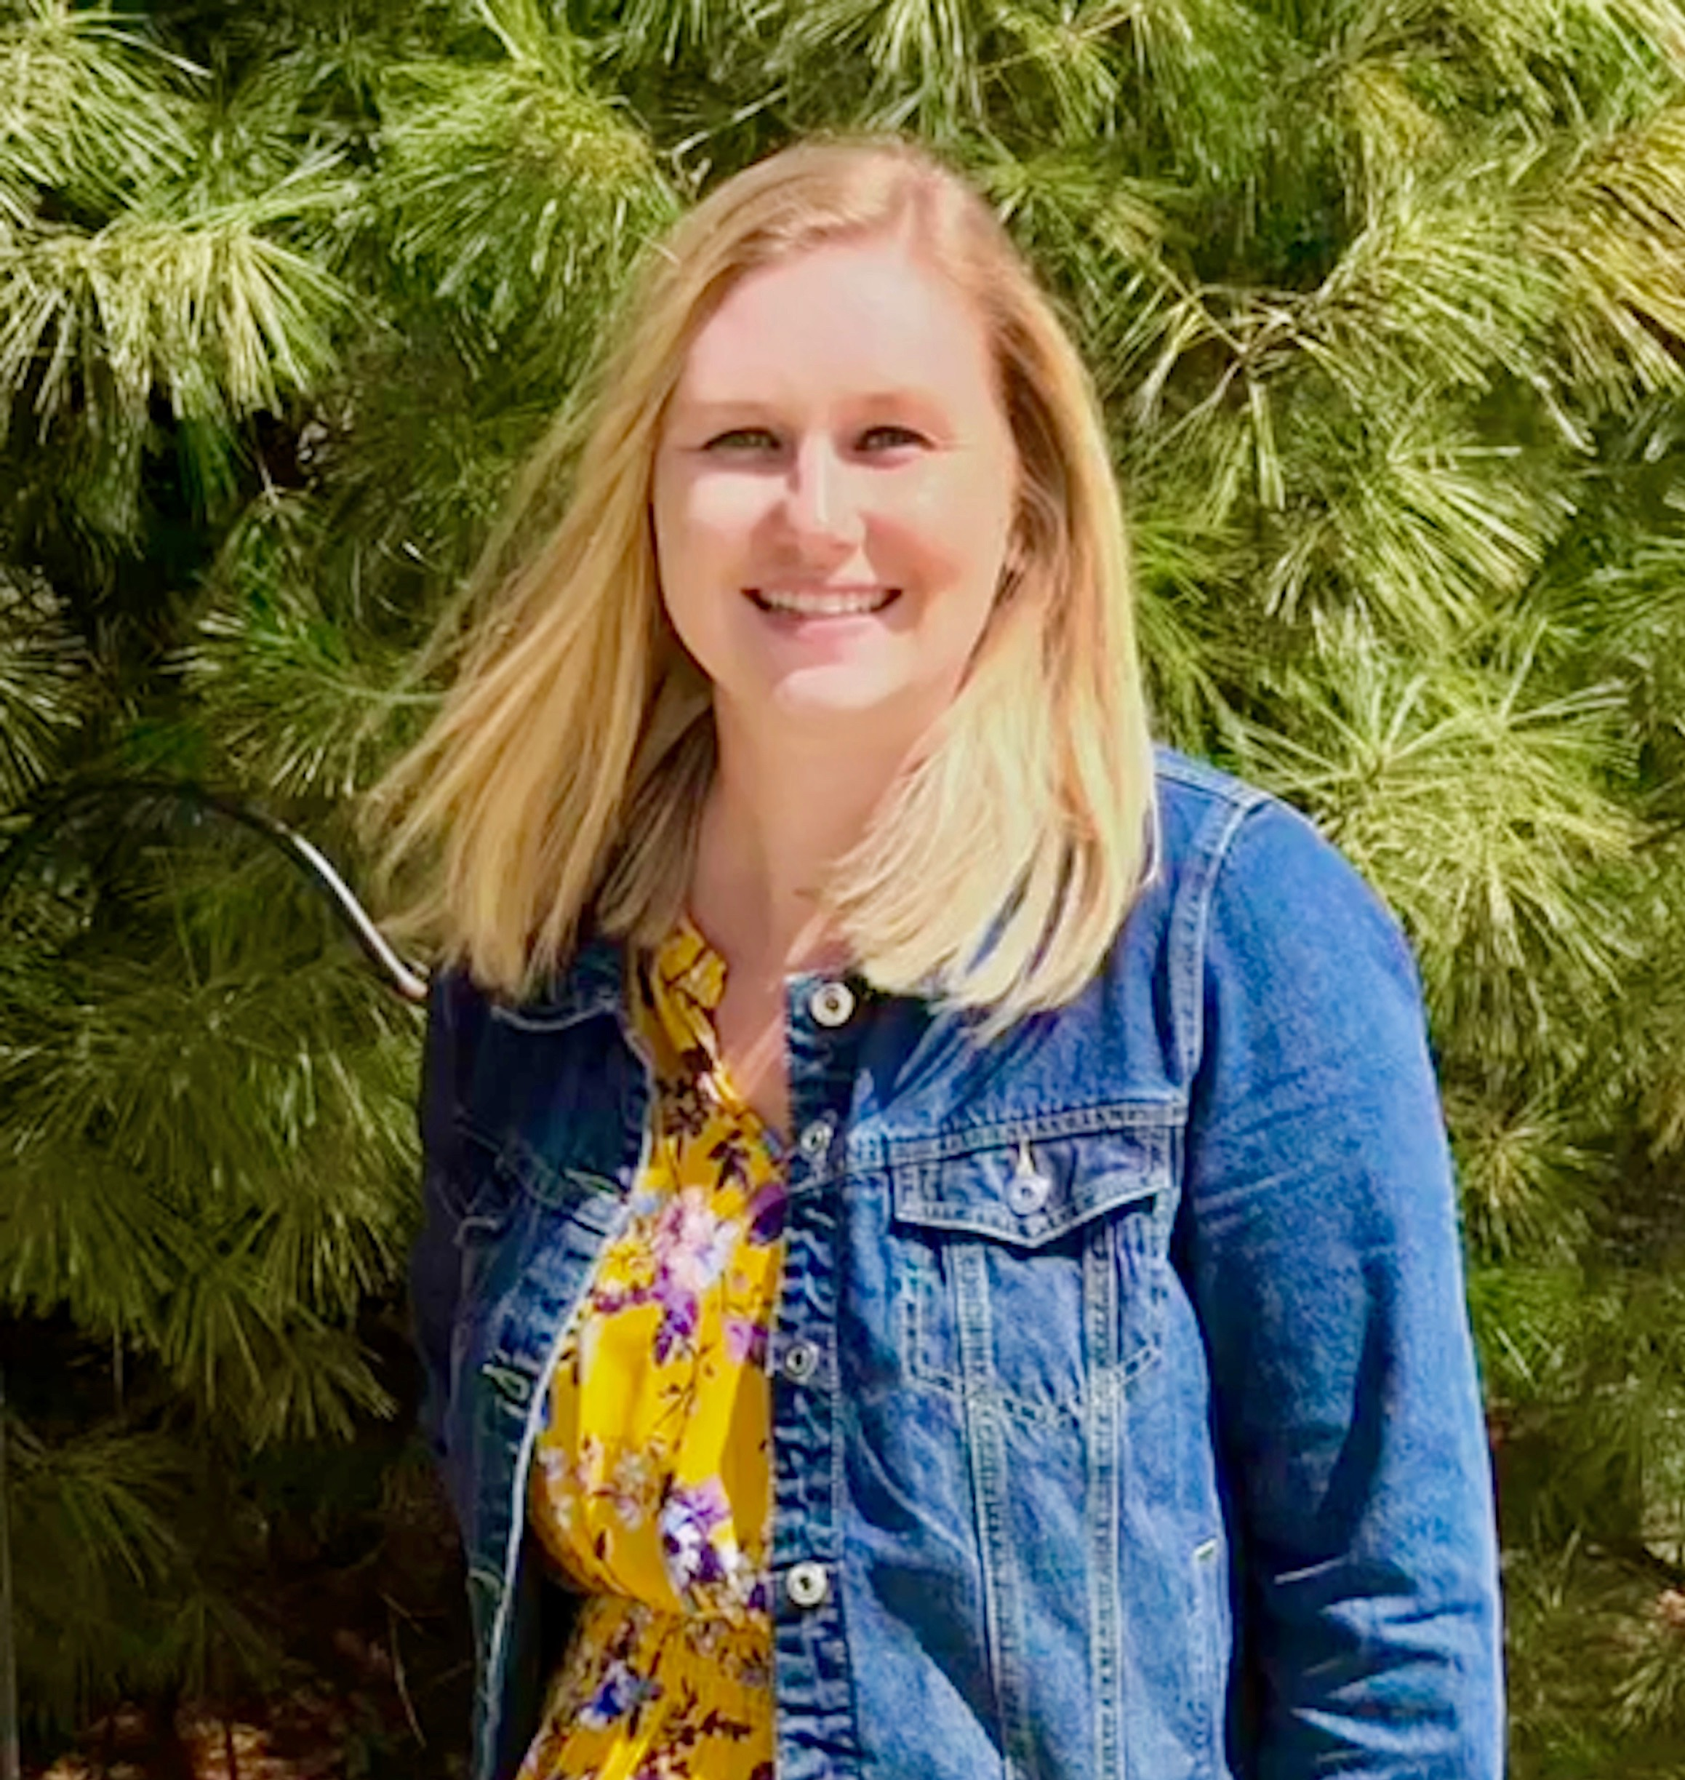
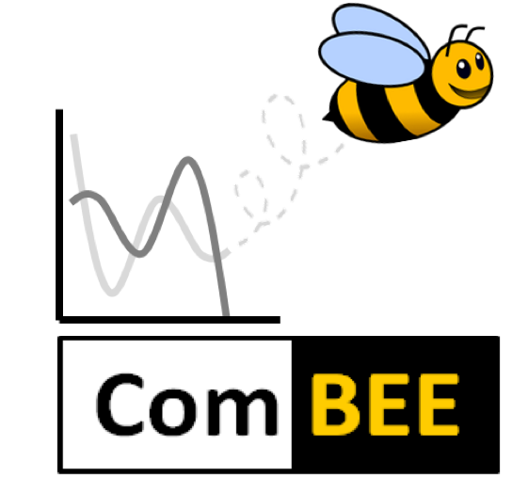
Elizabeth McDaniel
PhD student in Microbiology Doctoral Training Program
emcdaniel@wisc.edu
Meta-’omics/comparative genomics of engineered wastewater systems
Computational Biology, Ecology, and Evolution Group (ComBEE)
Peer-led study group of researchers interested in applying computational biology techniques to topics in ecology and evolution
Bi-weekly study groups in R/python
Monthly meetings/informal seminars on topics in ecology & evolution
Fall Social scheduled for September 6th @ 4PM – MSB 6201
Join the listserv by sending an email to join-combee@lists.wisc.edu
combee-uw-madison@github.io
Notes:
Stop for introductions
Talk to 1-2 people around you by: summarizing your research/work in three words (and then briefly describe it) sharing one thing you hope to learn at this workshop

Slide 4
What is Data Carpentry?
Workshop by The Carpentries
Non-profit, international organization
Workshops to help researchers adopt reproducible computational practices
Instructors and helpers are all volunteers
Materials developed by an open science community
Code-along learning model

Slide 5
Code of Conduct
Use welcoming and inclusive language
Be respectful of different viewpoints and experiences
Gracefully accept constructive criticism
Focus on what is best for the community
Show courtesy and respect towards other community members
Contact Sarah Stevens if you experience conduct violations
http://software-carpentry.org/conduct/

Slide 6
Workshop Logistics
Restrooms:
Across the hall (or on the first floor)
Food:
Coffee/tea in morning
No lunch provided (Aldo’s café, Saffron downstairs, Union South across street)
Lunch social – instructors will be around
Microwave and fridge available

Slide 7
Schedule
Morning:
Introduction to R
Lunch
Afternoon:
Data wrangling and visualization in R

Slide 8
Workshop Logistics
Workshop Website https://go.wisc.edu/3183gc
Etherpad (for collaborative notes and questions) https://go.wisc.edu/f778p7
Lessons https://datacarpentry.org/genomics-workshop/
Make sure you can connect to your Cyverse account!

Slide 9
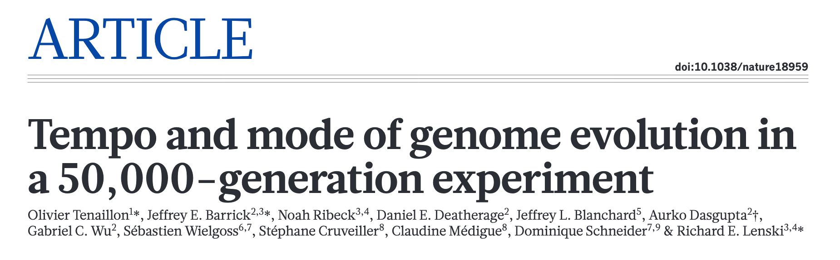
Long-term evolution experiment (LTEE) in E. coli
Wanted to understand the genomic and phenotypic changes of evolution
Founded 12 replicate populations under identical conditions in February 1988
Sequenced whole genomes from 2 clones from each population at 11 time points
Notes:
re introducing the study from which we are analyzing data

Slide 10


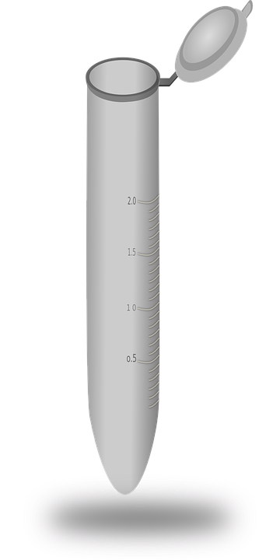
12 populations
24 samples
X 11 time points =
264 samples!

Slide 11
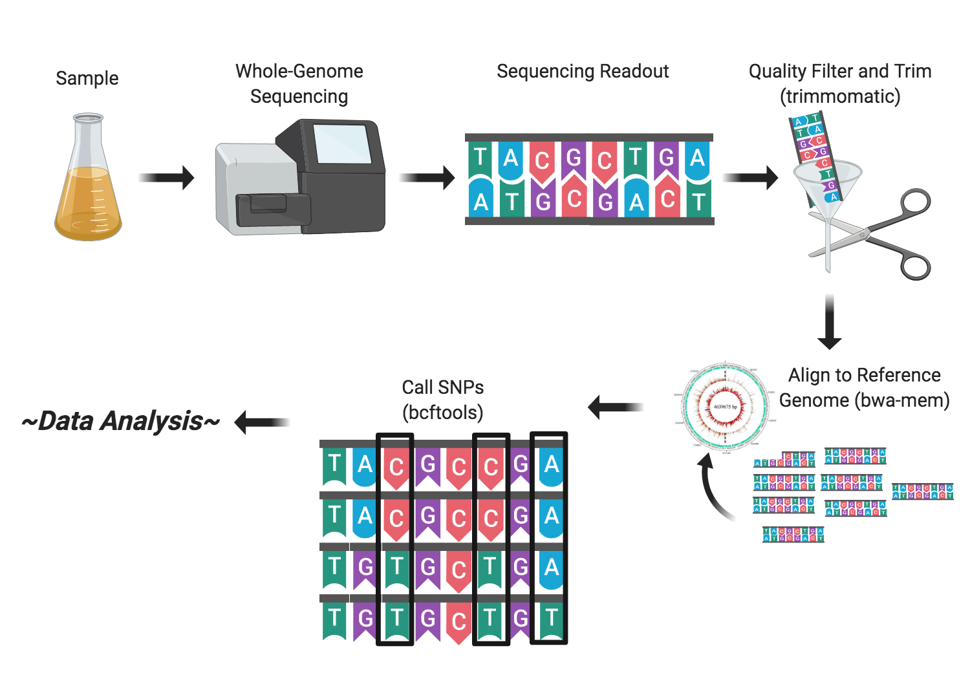
Last Week: Creating a Genomics Pipeline
Notes:
pipeline steps we went through in the first part of the workshop

Slide 12
What biological questions pertaining to the LTEE could you ask with our SNP data?
Discuss amongst your table and write your thoughts in the Etherpad
Notes:
discussion time

Slide 13
What is R?
“R” refers to both the programming language itself, and the software platform to interpret script written in it

Slide 14
Why should I learn R?
Less pointing and clicking
Writing scripts makes analyses more reproducible than clicking a series of buttons > remember what you did and can share with others
Interdisciplinary (field-specific extensions or packages) for genomics, statistical simulations, etc.
Takes data of all shapes and sizes
Produce high-quality graphics without $$$
Large, welcoming, open source community always developing new packages

Slide 15
What is RStudio?
Rstudio is an Integrated Development Environment (IDE) for working with R
Can write code, navigate files, view variables you created, and inspect plots within Rstudio
Lots of other IDEs that can suit a wide variety of programming languages

Slide 16
If you do not:
Have a Cyverse instance running and can access the IP address
Have RStudio and the tidyverse package installed on your local computer
Raise your tent to the red side
Notes:
stop and make sure everybody is good to go

Slide 17
Before we start:
Resources to get help
Resources on campus
RStudio universe/packages
Notes:
talk about resources before diving into lots of R

Slide 18
How do I find help?
…and more!
Notes:
google be your friend

Slide 19

Resources on campus
Social Sept. 6th @ 4 PM in MSB 6201
Study groups
Monthly seminars
Elizabeth McDaniel
emcdaniel@wisc.edu
Kirsten Gotting
gotting@wisc.edu
Sarah Stevens
facilitator@datascience.wisc.edu
Office hours to get help on all coding needs!
Tobin Magle
tobin.magle@wisc.edu
R workshops at Steenbock library
chtc@cs.wisc.edu
Christina Koch
Lauren Michael
Office hours to help with your coding needs on CHTC cluster
Notes:
combee, have r study groups or get help on ‘omics related questions
steenbock library office hours/r workshops
sarah stevens at the data science hub has office hours
wanting to run code on CHTC
CCI virtual machines - $$$ but through university

Slide 20
The world of R/Rstudio
https://www.bioconductor.org/
Over 1700 packages for analyzing and visualizing genomic data
Extensive documentation and vignettes (example demos) for packages
Workflows for common analyses: differential gene expression, annotation, etc.
Notes:
talk about resources before diving into lots of R

Slide 21
Accessing the RStudio server
Cyverse account, find your IP address in Projects > enter project that your instance was created > click on project > find IP address such as 128.196.142.78 (do not use this address!)
Enter the IP address into your web browser, followed by :8787, such as 128.196.142.78:8787
Username: dcuser
Password: data4Carp
Green side of tent when you are logged in, or already have RStudio/tidyverse packages installed locally
Notes:
talk about resources before diving into lots of R

